Slide 1
Physiological changes at birth
Dr Priyantha Perera

Slide 2
Physiological changes at birth
Fetus is dependent on mother for nutrition, gas exchange and excretion of waste products
Placenta provide all these functions
Once the umbilical cord is clamped baby has learn to survive independently for survival
By term most organ systems are well developed anatomically, but not functionally mature

Slide 3
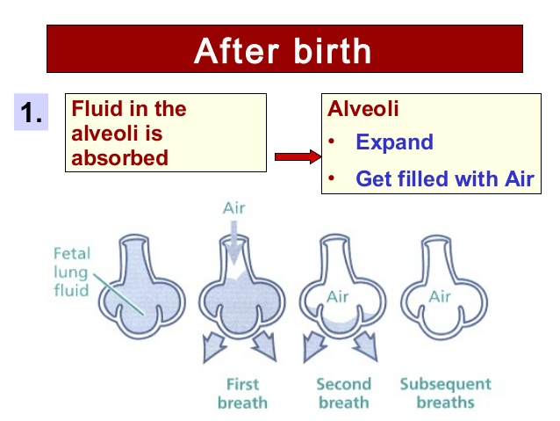
Alveolar changes at birth

Slide 4
Physiological changes at birth
Main changes take place in the respiratory system
Breathing movements are observed since around 32 week, but only amniotic fluid move in and out
Alveoli remain in collapsed state and filled with amniotic fluid
With first few breath fluid in the alveoli are pushed in to the circulation and lymphatics
Alveoli start to expand with the help of surfactant
Fetuses begin to produce surfactant between weeks 24 and 28. By 35 weeks, most babies produce surfactant to keep the alveoli from collapsing.

Slide 5
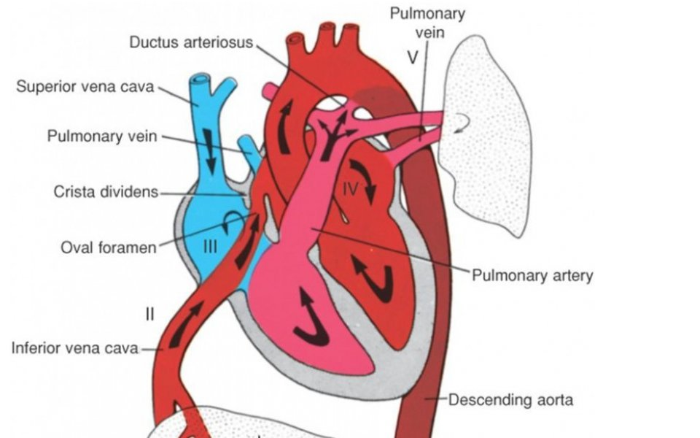
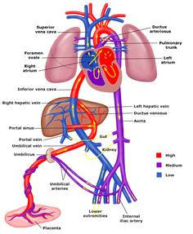
Fetal circulation

Slide 6
Circulatory changes at birth
Other major change take place in circulation
Site of gas exchange shifts from placenta to lungs
With aeration of alveoli, pAO2 and paO2 increase
This results in pulmonary vasodilatation and drop in pulmonary vascular resistance
This cause drop in pulmonary blood pressure
Pressure in left side of the heart increase than right

Slide 7
Circulatory changes at birth
Now blood flow from left atrium to right through foramen ovale
This cause functional closure of foramen ovale
Blood flow reverse through DA from aorta to pulmonary artery
This induce closure of the ductus
With no flow through ductus venousus it collapses
Thus the systemic and pulmonary circulations are now parallel

Slide 8
Persistent fetal circulation
If these changes fail to occur pulmonary pressure remains high and right to left shunting continue
This results in cyanosis and ill baby
Meconium aspiration syndrome is well known to cause this
It is also called persistent pulmonary Hypertension

Slide 9
Other organ systems
GI system is mature anatomically and functionally by term
Kidneys are functioning even during intra-uterine life
Brain has all neurons and only myelination and synapse formation continue

Slide 10


Slide 11
Summery
First breath at birth trigger all changes that need for independent survival
Primary changes take place in lungs where expansion of alveoli take place
With drop in pulmonary pressure circulatory changes take place

